Slide 1
오전과제

Slide 2
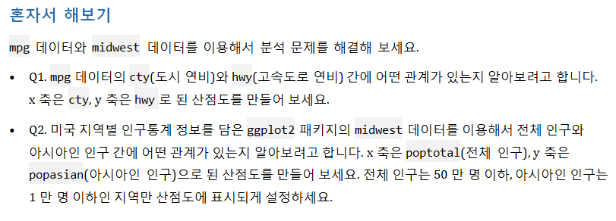
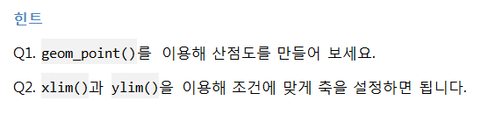
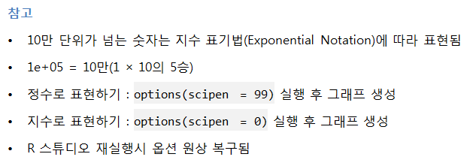

Slide 3
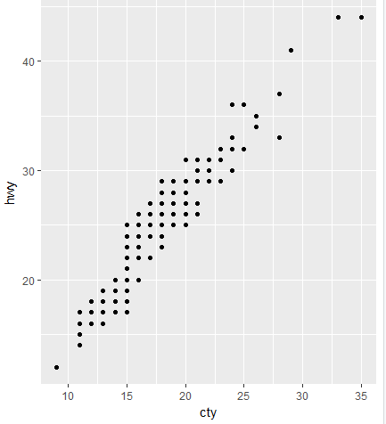
1번문제
ggplot(data=mpg,aes(x=cty,y=hwy))+geom_point()

Slide 4
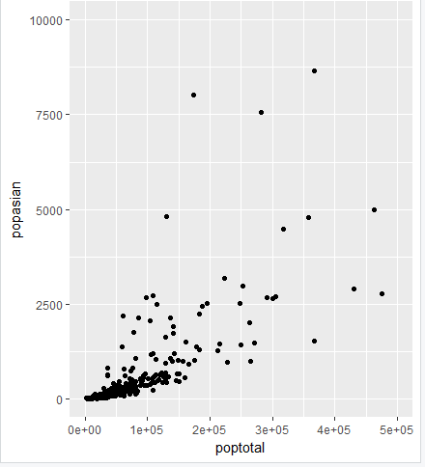
2번문제
ggplot(data=midwest,aes(x=poptotal,y=popasian))+geom_point()+xlim(0,5e+05)+ylim(0,1e+04)

Slide 5



Slide 6
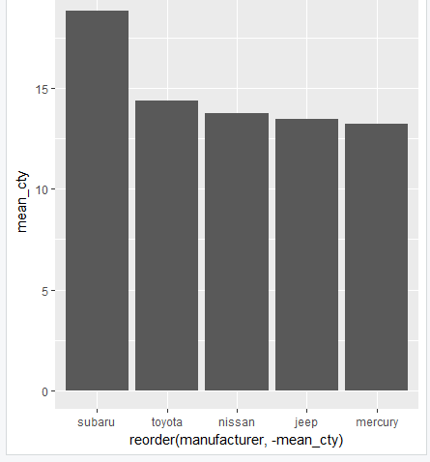
df_mpg<-mpg %>%
filter(class=="suv") %>%
group_by(manufacturer) %>%
summarise(mean_cty=mean(cty)) %>%
arrange(desc(mean_cty)) %>%
head(5)
df_mpg
ggplot(data=df_mpg, aes(x=reorder(manufacturer,-mean_cty),y=mean_cty))+geom_col()

Slide 7
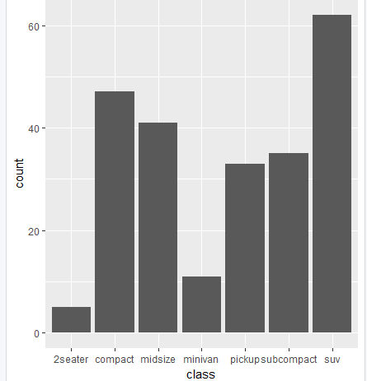
ggplot(data=mpg,aes(x=class))+geom_bar()

Slide 8


Slide 9
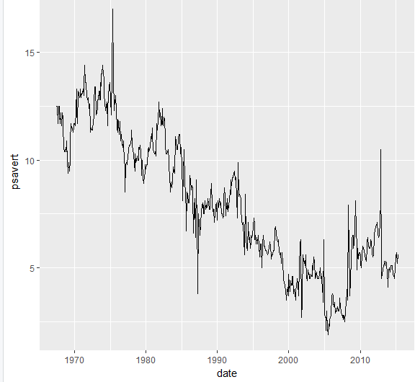
ggplot(data=economics,aes(x=date,y=psavert))+geom_line()

Slide 10



Slide 11
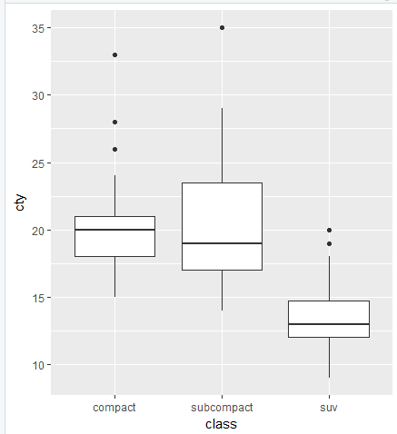
df_mpg<-mpg %>%
filter(class %in% c("compact","subcompact","suv"))
ggplot(data=df_mpg,aes(x=class,y=cty))+geom_boxplot()

